Slide 1
Blackwell Electronics Customer Buying Pattern
Data mining - customer patterns (Task 1)
Andres Saucedo

Slide 2
Keeping Pace with Insightful Knowledge
Challenge:
Market environments today are faced with multiple challenges that require businesses to be more adoptive, agile, and insightful to both internal and external threats impacting the bottom line. In the global market the new reality is not only maintaining traditional brick-and-mortar stores but strategically thinking about the online/virtual consumer trends and address challenges that were not historically relevant before the digital age.
Call to Action:
Blackwell Electronics has been in operation over 40 years with a large traditional store footprint in the Southeast. In order to keep pace with technological advancements, expanding customer base, and consumer buying trends; Blackwell Electronics launched an eCommerce website a year ago to initiate a new strategic revenue stream. In order to better understand the current state environment and strategically define the future state; a ‘call to action’ to better understand not only customer buying patterns but maximize revenue from eCommerce sales.
The charter of this report is to analyze the existing transaction data and gain meaningful insights into customer buying patterns.
10,000 transaction records (observations) will be analyzed as part of the sample dataset; which comprise of the following data types:
Customer Demographics – Age
Regions
Amount Spent ($)
In-store vs Online
Number of Items Purchase

Slide 3
Understanding the Data
Before fully analyzing the dataset, the Technology Office team took a methodical approach to understanding the existing data. To ensure that senior leadership at Blackwell Electronics are provided with the best possible information for strategic direction, this phase and iterative approach was taken.
The pre-processing phase is a fundamental aspect before the data mining and analysis can be made. Transformation of specific data types needed to be completed; such as, “in-store” & “region” attributes were transform from numerical to nominal data types.
As part of the iterative process, the team ran various predictive models to identify the best data correlations and outcomes; as well as, further processing of specific data points into categorical aspects for analysis purposes.
Data Acquisition
Pre-Processing
Analysis & Predictions
Business Insights
Transaction Dataset
10K records
Data Cleansing
Data Transformation
Categorization
Cross Validation
Decision Models Testing
Understanding & Identifying Patterns and Correlations

Slide 4
Initial Observations
Data Acquisition
Pre-Processing
Analysis & Predictions
Business Insights
Before taking a deep dive insight customer buying patterns some initial observations were observed as shown in the charts and tables.
The eCommerce platform has been initiated for only a year but it accounts for 57% of the revenue and makes up 54% in all transactions between the observed regions.
West region is 100% of online transactions.
Key Takeaways & Questions to Further Explore?
Why online sales in the East region are low?
Online sales in all other region seem to dominate compare to in-store. What correlations can be made? Does age predict whether customer will buy online or in-store?
Can we predict customer age between regions? Does age correlate for online vs in-store buying?
~$4.7M
~$3.5M
~$8.3M
10K
Transactions
Region | Total Revenue | Breakout of Revenue | % of Total Transactions | % of Total Rev
Central | $4,145,945.11 | $2,479,944.72 → Online Rev | 32% | 50%
 |  | $1,666,000.39 → In-Store Rev
East | $1,538,888.72 | $328,471.41 → Online Rev | 20% | 18%
 |  | $1,210,417.31 → In-Store Rev
South | $2,027,810.80 | $1,326,317.42 → Online Rev | 22% | 24%
 |  | $701,493.38 → In-Store Rev
West | $637,357.18 | $637,357.18 → Online | 26% | 8%
32%
20%
22%
26%
Table 1

Slide 5
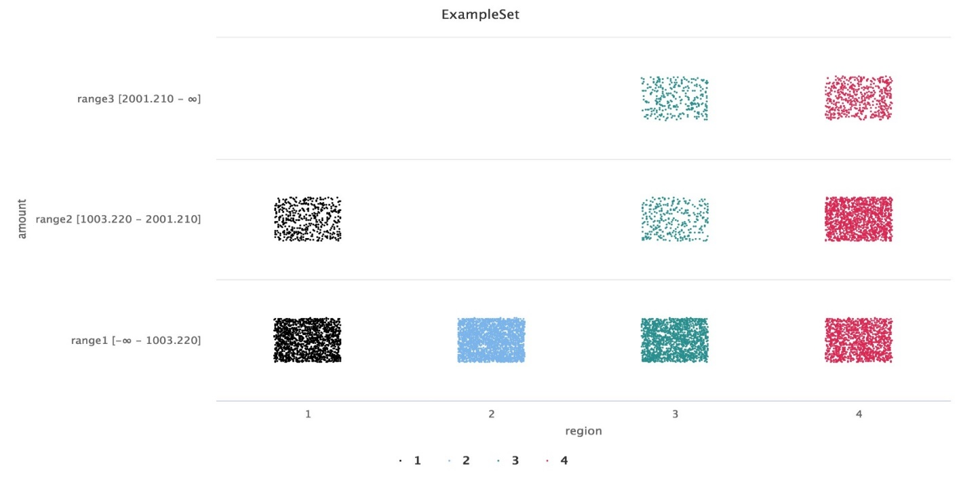
Analysis & Predictions
Data Acquisition
Pre-Processing
Analysis & Predictions
Business Insights
Our first objective in our data mining approach was to further understand the regions in more details. As seen from our ‘initial observations’ the Central region out-performed the other 3 regions by bringing in nearly 50% of the revenue and accounted for the largest dollar amount in the online and in-store category. A question we try to address was do customers in different region spend more per transaction; and which regions spent the most and least?
Observations
The national average was $835 per transaction.
Central region significantly exceeded the national average with an average spend of $1,290.37. But made up 32.13% of the total volume of sales (largest among the regions).
The lowest average was the West region with $250.53. Interestingly, the West region accounted for the second largest volume of sales (25.44%). We identified that the West region was entirely made up of online sales; could this be an indicator why the average is the lowest?
% of volume
Approach – segmented the sales ‘amount’ for further analysis
Categorized the “amount” attribute into 3 ranges to segment our data
Range 1: $0 - $1003.22
Range 2: $1003.22 - $2001.21
Range 3: >$2001.21
Key Observations:
West: 100% of transactions were in Range 1. This could be a reason for the lowest sales revenue and average.
South & Central regions had transactions within Range 3 which supports why they exceeded the average spend per transaction.
13%
17%
Range 3
Scatter Plot: Region by Ranges
24%
14%
43%
Range 2
Range 1
76%
100%
73%
40%
East
West
South
Central

Slide 6
Analysis & Predictions (con’t)
Data Acquisition
Pre-Processing
Analysis & Predictions
Business Insights
To further explore our dataset, we wanted to understand if there are differences in the age of customers between regions; if so, could we predict the age of a customer in a region based off other demographic data. Our first step was segmenting the “age” data into categories by age: Range 1 (0-34.75), Range 2 (34.75-51.5), Range 3 (51.5-68.25), and Range 4 (68+). From the start, it is observed that the Central region does not have an over population over the age of 68 but yet the highest population of younger consumers. The West region has the lowest populate of customer under 34 years but highest population of older customer 51+ years of age (60.46%) within that region. The South and East region have roughly similar distribution of customer in range 1, 2, and 3. Shockingly, given the older population base within the West region it had 100% online transactions.
Given the information, we wanted to investigate if we could predict the age of a consumer in a region. The predictive model we created was a decision tree classification which we set our dependent variable to ‘age’. The overall accuracy was 36.86% which lead us to be this to be a poor model fit for predictive purposes.

Slide 7
Analysis & Predictions (con’t)
Data Acquisition
Pre-Processing
Analysis & Predictions
Business Insights
An additional analysis consideration to determine was if there is the correlation between the age of a customer and whether their transaction was made in-store or online; and do other demographic data predict if a customer will buy online or in-store? Through our analysis we found that online transactions have greater frequency then in-store transactions (54% vs 46%). Surprisingly, the belief that the older consumer population prefers in-store purchases is inaccurate and the data leads us to believe that the older generation over 51 years old (range 3 & 4) make more online purchase. Other key observations include:
Transactions over the amount of $2001.21+ (range 3) only took place ONLINE (see chart on following slide).
Amount Range 2 ($1003-$2001) have the largest revenue within the IN-STORE transactions within our younger and middle age customer base (0 to 51 years of age) (see chart on following slide).
From our predictive models created, we found that a strong correlation exist between customer age and whether they will purchase via online or in-store. Some predictor values identified were region, amount, item and age all contribute to predicting in-store purchase. The overall accuracy of the prediction was 83.14%.

Slide 8
Analysis & Predictions (con’t)
Data Acquisition
Pre-Processing
Analysis & Predictions
Business Insights

Slide 9
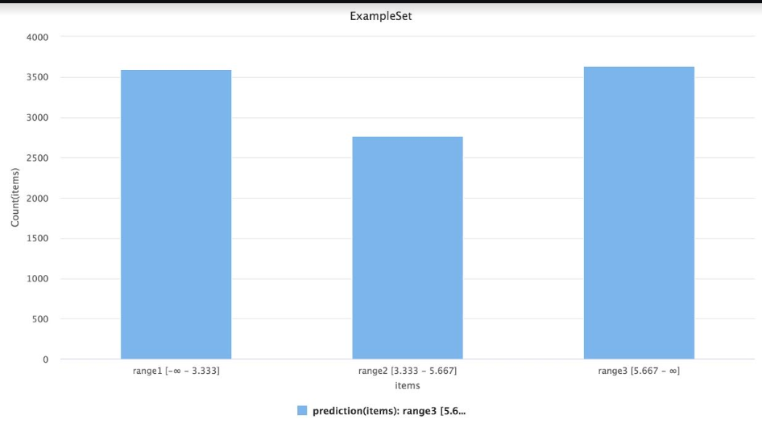
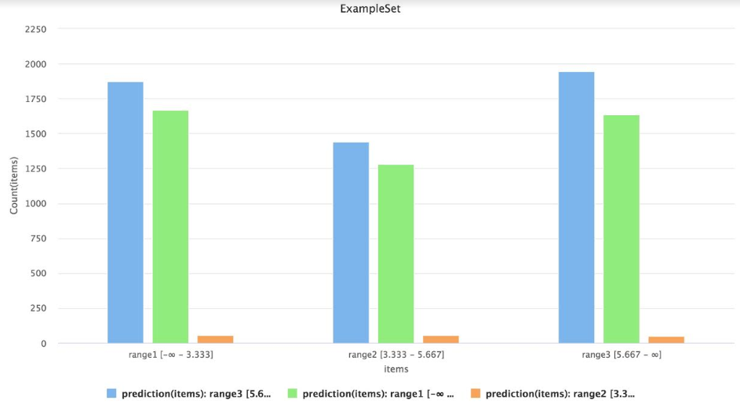
Analysis & Predictions (con’t)
Data Acquisition
Pre-Processing
Analysis & Predictions
Business Insights
While continuing to examine our dataset, we wanted to identify if there were any correlations/relationships between the number of items purchased and amount spent. We tested two different predictive models to determine if any correlation exist.
Model 1: Decision Tree
Model 2: ID3 (Iterative Dichotomiser 3) Decision Tree
Our initial predictive model produced inconclusive results with a 36.32% accuracy. This is a poor model fit. The model was able to predict the following item ranges with the following precision.
Range 1 (0 to 3) Items: 0.00%
Range 2 (3 to 5) Items: 0.00%
Range 3 (5 +) Items: 36.32 %
We decided to test another predictive model to the left (model 2) to seek better results.
The ID3 predictive model produced slightly marginal better results with an accuracy of 37.04%. Still not a good model for predicting Items. The following class precisions for items were observed for item ranges:
Range 1 (0 to 3) Items: 36.78%
Range 2 (3 to 5) Items: 31.25%
Range 3 (5+) Items: 37.42%
Again as model 1, the results are inconclusive to make strategic predictions for business decisions.
Takeaway – all predictions within each Range class (1, ,2, 3) is predicting Range 3 which his inaccurate
Takeaway – predictions for each Range class (1,2,3) are being somewhat refined for accuracy but still inaccurate.
Prediction: Range 3
Prediction: Range 3
Prediction: Range 1
Prediction: Range 2
Prediction: Range 2
Prediction: Range 2
Prediction: Range 3
Prediction: Range 1
Prediction: Range 1
Range 1: [0-3]
Range 2: [3-5]
Range 3 [5+]
Range 1: [0-3]
Range 2: [3-5]
Range 3 [5+]
Range 1: [0-3]
Prediction (items): Range 3
Prediction: Range 3
Prediction: Range 1
Prediction: Range 2

Slide 10
Insights
Data Acquisition
Pre-Processing
Analysis & Predictions
Business Insights
01. Online Sales
03. Data & Conclusions
From the initial data analysis, the Technology team was able to address some immediate questions that will help Marketing and Sales better align the eCommerce platform.
Unlike original perceptions that older customers prefer to shop in-shore compared to younger people. The data indicates that 42% of the online sales are made by customers over the age 51.
The older customer base (51+) only accounted for 13% of in-store transactions while customers under the age 51 accounted for 33%.
The existing data is a great starting point to understanding our customer buying patterns and assist the eCommerce team with making strategic business decisions. Significant analysis was conducted to draw conclusions on regional sales/transactions, customer age and prediction by region, correlation of customer age and buying preference (instore/online), and other aspects to drive insightful decisions.
Data mining and predictive analytics is an iterative process, so it would be recommended to further explore if other demographic data exist to expand the analysis in new dimensions.
02. Regions
Interestingly there is an odd region that made up 100% of Online transactions. This begs the questions:
Did we receive a full data set for this region?
Are there any physical stores in this region?

